Slide 1
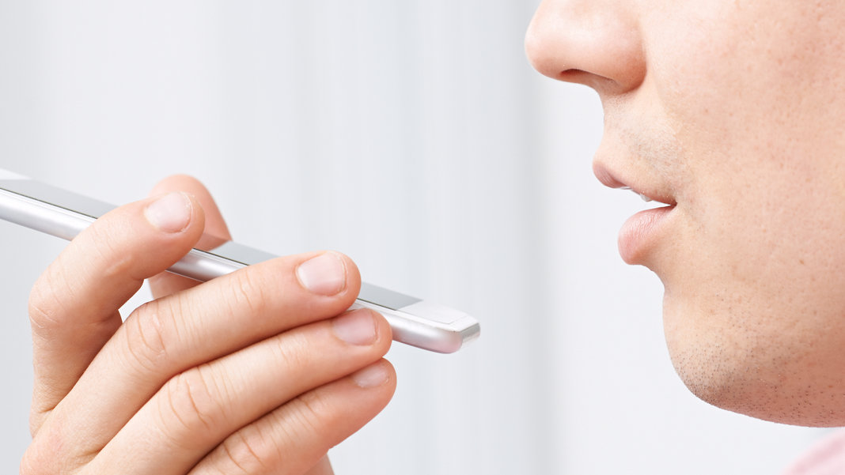
Voice Assistant

Slide 2


Python Project
On
Voice Assistant
Submitted by
Prince Kumar Deka (12006624)
Ankit Kumar (12007097)

Slide 3
tech

Slide 4
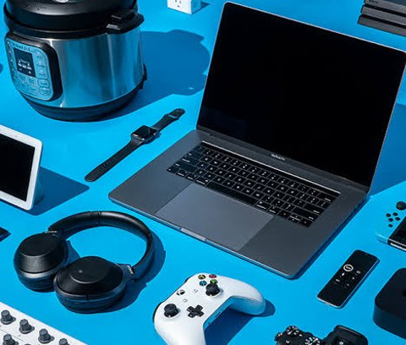
Introduction
A voice assistant is a computer assistant that listens to particular voice commands and returns relevant information or performs specified actions as desired by the user using speech recognition, language processing algorithms, and voice synthesis.
Today, voice assistants are integrated into many of the devices we use on a daily basis, such as cell phones, computers, and smart speakers.

Slide 5
Tools used
Python
VS Code
PIP
Pycharm

Slide 6
Modules Used
pyttsx3
Pyttsx3 is a python text-to-speech conversion library
Is compatible with Python 2 and 3.
speech_recognition
Allows for automated voice recognition and conversion to text.
Datetime
Allows to Import and use datetime module to work with the date and time
effectively.

Slide 7
Webbrowser
The webbrowser module allows users to view web-based content.
Wikipedia
Wikipedia makes makes it easy to access and parse data from
Wikipedia and get article summaries, get data like links and
images from a page, and more.

Slide 8
Features
Introduction of assistant with some common talks
Cracking jokes, telling news
Accessing youtube, google and mail
Accessing today's day, date and time
Shutting down the system
Exiting the program

Slide 9
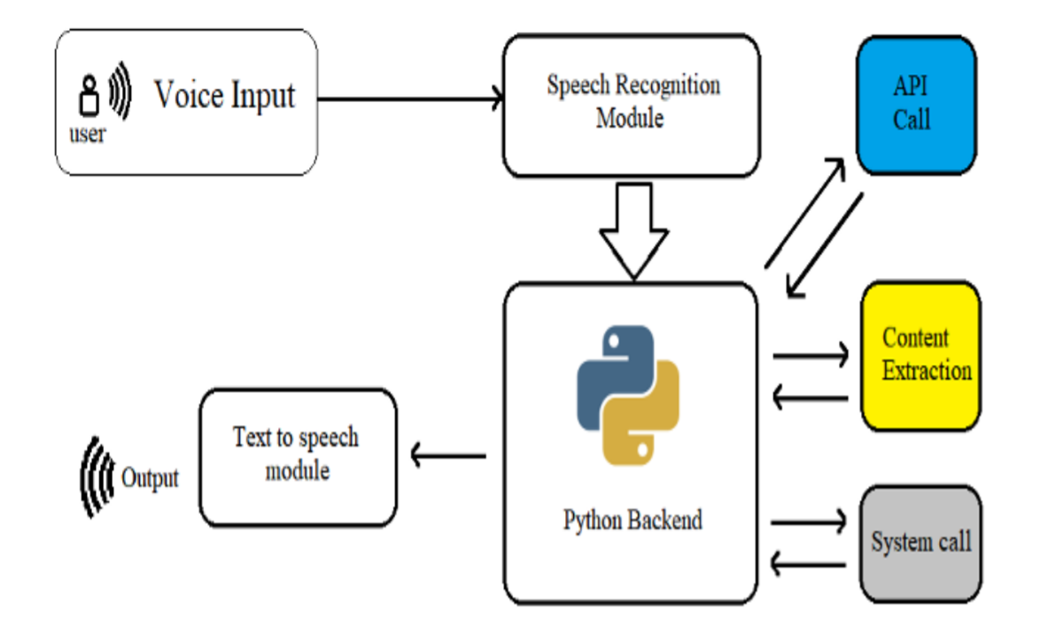
Flowchart Diagram

Slide 10
Future perspective
To make things more automated using voice assistant
To strip back the physical hardware as far as possible
To Make it easier to operate a computer for the disables by hand.
Many more

Slide 11
Conclusion
Voice assistants are currently driving the digital realm. Voice instructions are taking the place of typing. Voice assistance is an important feature used in house automation and in artificial intelligence devices. It enable a highly engaging user experience. Users can speak to the applications naturally to ask for whatever they'd like and can do so while multitasking. Also in voice interaction in manufacturing and construction environments, allowing workers hands-free access to relevant knowledge on demand. And there are many more possibilities.

